Slide 1
Antihypertensive Drugs
Yacoub M. Irshaid, MD, PhD, ABCP
Department of Pharmacology, FOM, UJ 2016
١

Slide 2
Reference
Basic & Clinical Pharmacology BG Katzung, SB Masters, AJ Trevor McGraw Hill LANGE
13th edition, Chapters 11 & 12
2

Slide 3
Hypertension
Sustained arterial hypertension damages blood vessels in kidney, heart, and brain and leads to an increased incidence of renal failure, coronary disease, heart failure, stroke, and dementia.
٣

Slide 4
Hypertension
Lowering of blood pressure leads to prevention of damage to blood vessels and substantially reduces morbidity and mortality rates.
٤

Slide 5
Hypertension
Diagnosis of hypertension depends on measurement of blood pressure and not on symptoms reported by the patient.
Hypertension is usually asymptomatic until overt end-organ damage has already occurred.
٥

Slide 6
Hypertension
Blood Pressure Categories:
SBP
< 120
DBP
< 80
Normal
Prehypertension
120-135
80-89
Hypertension Stage 1
Stage 2
140-159
≥ 160
90-99
≥ 100
٦
The actual reading by itself may be less important than in the presence of vascular damage or target organ damage.

Slide 7
Etiology of Hypertension
1. Essential (Primary) hypertension: no specific cause of hypertension could be identified. It constitutes 85- 90% of cases.
Elevation of blood pressure is usually multi-factorial.
٧

Slide 8
Etiology of Hypertension
Genetic factors, psychological stress, and environmental and dietary factors (increased salt and decreased potassium or calcium intake) contribute to the development of hypertension.
٨

Slide 9
Etiology of Hypertension
2. Secondary hypertension: Constitutes only 10-15% of cases and include renal artery stenosis, coarctation of the aorta, pheochromocytoma, Cushing’s disease, and primary aldosteronism.
These are amenable to definitive
surgical treatment.
٩

Slide 10
Hypertension
Physiologic regulation:
Moment-to-moment:
Arterioles
Postcapillary venules
Heart
Long-term:
d. Kidney
١٠

Slide 11
Hypertension
Baroreflexes + Renin-angiotensin- aldosterone system coordinate function at the 4 control sites.
Local release of hormones from the vascular endothelium may contribute to regulation of vascular resistance:
١١

Slide 12
Hypertension
Nitric oxide: dilates
Endothelin-1: constricts
In hypertensive patients, the same mechanisms operate but the control system (baroreceptors and the renal blood volume-pressure control systems) appears to be reset at a higher level of blood pressure.
١٢

Slide 13
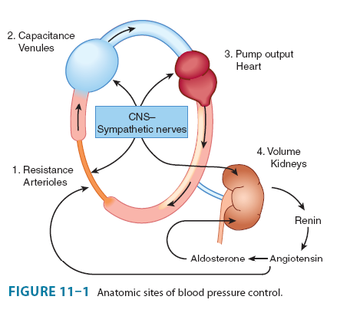
١٣

Slide 14
Postural Baroreflex
Baroreflexes are responsible for rapid, moment-to-moment adjustments in blood pressure, such as in transition from a reclining to an upright posture.
١٤

Slide 15
Postural Baroreflex
Carotid baroreceptors are stimulated by the stretch of the vessel walls brought about by arterial blood pressure, resulting in inhibition of central sympathetic discharge (from the vasomotor center in the medulla).
Conversely, reduction in stretch results in a reduction in baroreceptor activity.
١٥

Slide 16
Postural Baroreflex
In the case of a transition to upright posture, baroreceptors sense the reduction in arterial pressure that results from pooling of blood in the veins below the level of the heart as reduced wall stretch, and sympathetic discharge is disinhibited.
١٦

Slide 17
Postural Baroreflex
This reflex increase in sympathetic outflow increases peripheral vascular resistance (constriction of arterioles) and cardiac output (direct stimulation of the heart) and constriction of capacitance vessels, which increases venous return to the heart, thereby
restoring normal blood pressure.
١٧

Slide 18
Postural Baroreflex
The same baroreflex acts in response to any event that lowers arterial pressure, including a primary reduction in peripheral vascular resistance (vasodilating agent) or a reduction in intravascular volume (due to hemorrhage or to loss of salt
and water via the kidney).
١٨

Slide 19
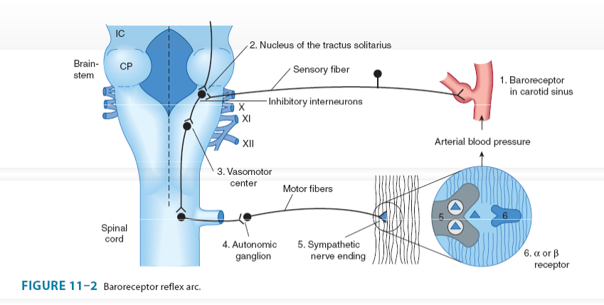
١٩

Slide 20
Renal Response to Decreased Blood Pressure
By controlling blood volume, the kidney is primarily responsible for longterm blood pressure control.
A reduction in renal perfusion pressure causes intrarenal redistribution of blood flow and increased reabsorption of salt and
water.
٢٠

Slide 21
Renal Response to Decreased Blood Pressure
In addition, decreased pressure in renal arterioles as well as sympathetic neural activity (via β adrenoceptors) stimulates production of renin, which increases production of angiotensin II.
٢١

Slide 22
Renal Response to Decreased Blood Pressure
Angiotensin II causes:
Direct constriction of resistance vessels.
Stimulation of aldosterone synthesis in the adrenal cortex, which increases renal sodium absorption and intravascular blood
volume.
٢٢

Slide 23
Renal Response to Decreased Blood Pressure
Vasopressin released from the posterior pituitary gland also plays a role in maintenance of blood pressure through its ability to regulate water reabsorption by the kidney.
٢٣

Slide 24
Antihypertensive Agents
Include the following:
1. Diuretics, which lower blood pressure by depleting the body of sodium and reducing blood volume and perhaps by reducing blood vessels responsiveness to vasoconstrictors.
٢٤

Slide 25
Antihypertensive Agents
2. Sympathoplegic agents, which lower blood pressure by reducing peripheral vascular resistance, inhibiting cardiac function, and increasing venous pooling in capacitance vessels.
٢٥

Slide 26
Antihypertensive Agents
3. Direct vasodilators, which reduce pressure by relaxing vascular smooth muscle, thus dilating resistance vessels and, to varying degrees, increasing capacitance as well.
٢٦

Slide 27
Antihypertensive Agents
4. Agents that block production or action of angiotensin and thereby reduce peripheral vascular resistance and (potentially) blood volume.
٢٧

Slide 28
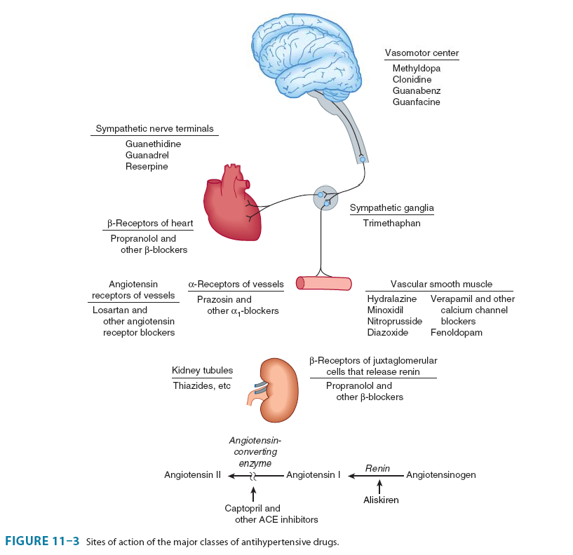
Antihypertensive Agents
٢٨

Slide 29
Antihypertensive Agents
Define (you should know):
Systemic vascular resistance.
Cardiac output.
Preload.
Afterload.
Postural (orthostatic) hypotension.
٢٩

Slide 30
Drugs That Alter Sodium & Water Balance
Dietary sodium restriction decreases blood pressure in hypertensive patients.
Diuretics lower blood pressure by depleting body Na⁺, thus reducing blood volume and cardiac output.
٣٠

Slide 31
Diuretics
After 6-8 weeks of therapy, cardiac output returns to normal but the systemic vascular resistance drops, due to decreased response to vasoconstrictors due to sodium depletion.
Sodium contributes to vascular resistance by increasing vessel
stiffness and neural reactivity.
٣١

Slide 32
Diuretics
This effect may be related to altered sodium-calcium exchange which increases intracellular calcium.
These effects are reversed by diuretics or dietary sodium restriction.
٣٢

Slide 33
Diuretics
Indapamide also has direct vasodilator action.
Thiazide diuretics are effective for mild-to-moderate hypertension in patients with normal renal and cardiac function.
Potassium-sparing diuretics are useful to avoid excessive potassium
depletion.
٣٣

Slide 34
Diuretics
Loop diuretics are necessary in severe hypertension with:
Multiple drugs that retain Na⁺ and water.
When GFR is < 30-40 mL/min.
Cardiac failure.
Cirrhosis when sodium retention is
marked (??).
٣٤

Slide 35
Drugs That Alter Sympathetic Nervous System Function
Include the following:
Centrally acting sympathoplegic drugs.
Ganglion-blocking agents.
Adrenergic neuron-blocking agents.
Adrenoceptor antagonists.
٣٥

Slide 36
Drugs That Alter Sympathetic Nervous System Function
All of these agents can elicit compensatory effects through adrenergic nerve-independent mechanisms: Retention of sodium by the kidney expansion of blood volume.
Thus, they are most effective when
used concomitantly with a diuretic.
٣٦

Slide 37
Centrally Acting Sympathoplegic Agents
Reduce sympathetic outflow from vasomotor centers in the CNS, but allow these centers to retain or increase their sensitivity to baroreceptor control, and thus, are less likely to produce postural hypotension.
٣٧

Slide 38
Methyldopa
Mechanism of Action:
It is converted in the CNS → α-methyldopamine →
α-methylnorepinephrine, which is stored in adrenergic nerve vesicles, replaces norepinephrine, and is released by nerve stimulation.
٣٨

Slide 39
Methyldopa
However, α-methylnorepinephrine released is an effective agonist at the α-adrenoceptors and can not explain the antihypertensive effect.
It stimulates central α₂-adrenoceptors that mediate the negative feedback on catecholamine release.
٣٩

Slide 40
Methyldopa
This reduces sympathetic outflow from CNS, decreases catecholamine release, reduces peripheral vascular resistance and cardiac output, and thus blood pressure.
Used primarily for hypertension of pregnancy.
٤٠

Slide 41
Methyldopa
Adverse Effects:
Little postural hypotension, but may occur in volume-depleted patients.
Sedation – most frequent at onset of treatment.
Impairs mental concentration.
٤١

Slide 42
Methyldopa
Nightmares, mental depression, vertigo.
Lactation: due to inhibition of dopaminergic transmission which stimulates prolactin.
Hepatitis and drug fever.
٤٢

Slide 43
Methyldopa
Positive Coomb’s test in 10-20% of patients taking the drug for > 12 months:
Makes cross-matching of blood difficult.
Rarely associated with hemolytic anemia.
٤٣

Slide 44
Clonidine
Clonidine is a 2-imidazoline derivative.
It is a direct agonist at central α₂- adrenoceptors, decreases circulating catecholamine levels, and reduces blood pressure.
It may sensitize brainstem vasomotor centers to inhibition by baroreflexes.
٤٤

Slide 45
Clonidine
After intravenous injection, it produces a brief rise in blood pressure followed by more prolonged hypotension.
The pressor response is due to direct stimulation of α-adrenoceptors in arterioles.
٤٥

Slide 46
Clonidine
The drug is classified as a partial agonist at α-receptors because it also inhibits pressor effects of other α agonists.
It reduces sympathetic and increases parasympathetic tone, resulting in blood pressure lowering and
bradycardia.
٤٦

Slide 47
Clonidine
Clonidine also binds to a the imidazoline receptor, which may also mediate antihypertensive effects.
Methyldopa and clonidine produce slightly different hemodynamic effects: clonidine lowers heart rate and cardiac output more than does
methyldopa.
٤٧

Slide 48
Clonidine
This difference suggests that these two drugs do not have identical sites of action.
They may act primarily on different populations of neurons in the vasomotor centers of the brainstem.
٤٨

Slide 49
Clonidine
Reduction in arterial blood pressure by clonidine and methyldopa is accompanied by decreased renal vascular resistance and maintenance of renal blood flow.
٤٩

Slide 50
Clonidine
Adverse effects:
1. Dry mouth and sedation are common. Both effects are centrally mediated and dose-dependent and coincide temporally with the drug’s antihypertensive effect.
٥٠

Slide 51
Clonidine
2. Clonidine should not be given to patients who are at risk for mental depression and should be withdrawn if depression occurs during therapy.
٥١

Slide 52
Clonidine
3. Concomitant treatment with tricyclic antidepressants may block the antihypertensive effect of clonidine, due to α-adrenoceptor-blocking actions of the tricyclics.
٥٢

Slide 53
Clonidine
4. Withdrawal of clonidine after prolonged use (and at high dosages), can result in life-threatening hypertensive crisis mediated by increased sympathetic nervous activity.
٥٣

Slide 54
Clonidine
The withdrawal syndrome is manifested by nervousness, tachycardia, headache, and sweating after omitting one or two doses of the drug.
All patients who take clonidine should be warned of this possibility.
٥٤

Slide 55
Clonidine
When the drug must be stopped, it should be done gradually while other antihypertensive agents are being substituted.
Treatment of the hypertensive crisis consists of reinstitution of clonidine therapy or administration of both α- and β-adrenoceptor-blocking agents^{٥٥} .

Slide 56
Adrenoceptor Antagonists
The pharmacology of α- and β- adrenoceptor blockers was presented in the autonomic nervous system pharmacology lectures in second year.
٥٦

Slide 57
β-Adrenoceptor Antagonists
Propranolol (non-selective, blocks β₁- and β₂-adrenoceptors) was the first β blocker shown to be effective in hypertension and ischemic heart disease.
It has now been replaced by cardioselective β₁-blockers such as bisoprolol, metoprolol and atenolol. ٥٧

Slide 58
β-Adrenoceptor Antagonists
All β-adrenoceptor blockers are useful for lowering blood pressure in mild-to-moderate hypertension.
In severe hypertension, they are especially useful in preventing the reflex tachycardia that results from treatment with direct vasodilators.
٥٨

Slide 59
β-Adrenoceptor Antagonists
They reduce mortality after a myocardial infarction, and some also reduce mortality in patients with heart failure.
They are indicated for treating hypertension in these conditions.
Reduce blood pressure without
prominent postural hypotension.
٥٩

Slide 60
β-Adrenoceptor Antagonists
Mode of action:
Reduction of cardiac output (β₁).
Inhibition of renin secretion (β₁) depression of renin-angiotensin- aldosterone system.
Block presynaptic β-adrenoceptors to reduce sympathetic
vasoconstrictor nerve activity.
٦٠

Slide 61
β-Adrenoceptor Antagonists
Major adverse effects:
Bradycardia (β₁-block)
Cardiac block (β₁-block)
Increased peripheral vascular resistance (β₂-block)
Bronchoconstriction (β₂-block)
Masking signs and symptoms of
hyperglycemia.
٦١

Slide 62
β-Adrenoceptor Antagonists
6. Withdrawal syndrome (nervousness, tachycardia, increased intensity of angina, increase of blood pressure, and myocardial infarction). β- blockers should not be discontinued abruptly. The withdrawal syndrome may involve upregulation or
supersensitivity of β-adrenoceptors.
٦٢

Slide 63
α-Adrenoceptor Antagonists
Prazosin, terazosin, and doxazosin are selective α₁-receptors blockers in arterioles and venules  dilation.
These agents produce less reflex tachycardia when lowering blood pressure than do nonselective a antagonists such as phentolamine.
٦٣

Slide 64
α-Adrenoceptor Antagonists
α₁-Receptors selectivity allows norepinephrine to exert unopposed negative feedback (mediated by presynaptic α₂-receptors) on its own release.
٦٤

Slide 65
α-Adrenoceptor Antagonists
In contrast, phentolamine blocks both presynaptic and postsynaptic α- receptors.
Block of α₂-receptors results in reflex activation of sympathetic neurons and greater release of norepinephrine and greater cardio-acceleration.
٦٥

Slide 66
α-Adrenoceptor Antagonists
α-Receptor blockers reduce arterial pressure by dilating both resistance and capacitance vessels.
Blood pressure is reduced more in the upright than in the supine position (postural hypotension).
٦٦

Slide 67
α-Adrenoceptor Antagonists
Retention of salt and water is a recognized adverse effect.
The drugs are more effective when used in combination with other agents, such as a β blocker and a diuretic, than when used alone.
٦٧

Slide 68
α-Adrenoceptor Antagonists
They relax prostatic smooth muscle.
They are used primarily in men with concurrent hypertension and benign prostatic hyperplasia and bladder neck obstruction.
٦٨

Slide 69
Vasodilators
Produce direct relaxation of vascular smooth muscle → vasodilation → decrease total peripheral vascular resistance (TPVR).
Relax arterial smooth muscle more than venous smooth muscle → minimal postural hypotension.
٦٩

Slide 70
Vasodilators
Neuroendocrine and autonomic reflexes compromise their antihypertensive effects:
1. Reflex sympathetic stimulation → increases heart rate, cardiac output and peripheral vascular resistance and thus, myocardial O₂ demand.
٧٠

Slide 71
Vasodilators
Elevation of plasma renin activity →
elevation of angiotensin II:
vasoconstriction: increases peripheral vascular resistance
elevation of aldosterone: Na⁺ and H₂O retention which increases blood volume.
٧١

Slide 72
Vasodilators
Inadequate as monotherapy for hypertension because of tolerance, but more useful when combined with diuretics and/or β-blockers.
٧٢

Slide 73
Hydralazine
It acts mainly by releasing nitric oxide (NO), EDRF.
Used orally.
It dilates arterioles but not veins. Pharmacokinetics:
t½ is ~ 1.5 -3 hours, which increases in slow acetylators and renal
insufficiency.
٧٣

Slide 74
Hydralazine
Well absorbed after oral administration, extensive first-pass metabolism by hydroxylation and acetylation.
There is genetic defects in the capacity to acetylate the drug (In Jordan, ~ 65% of the population are
slow acetylators).
٧٤

Slide 75
Hydralazine
Adverse effects:
Headache, flushing, nasal congestion, palpitations, tachycardia, and thus, myocardial ischemia.
Peripheral neuropathy and drug fever are other serious but uncommon adverse effects.
٧٥

Slide 76
Hydralazine
3. Lupus-erythematosus like syndrome, especially in slow acetylators (arthralgia, myalgia, skin rashes, and fever, but no renal damage).The syndrome is reversed by discontinuation of the drug.
٧٦

Slide 77
Minoxidil
Mechanism of Action:
Metabolized in the liver to minoxidil sulfate, which is a K⁺-channel opener in smooth muscle → hyperpolarization and relaxation of smooth muscle
Used orally.
It dilates arterioles but not veins.
٧٧

Slide 78
Minoxidil
Adverse Effects:
Those of hydralazine in “1”.
Growth of body hair (hypertrichosis): Troublesome for women.
Can be used for male pattern baldness topically (Rogaine), but the effect is lost after stopping the drug.
٧٨

Slide 79
Diazoxide
Chemically similar to thiazide diuretics but without a diuretic action
Mechanism of Action:
Opens K⁺-channels and cause hyperpolarization of vascular smooth muscle.
Long-acting agent.
•
Tolerance develops rapidly.
٧٩

Slide 80
Diazoxide
Pharmacodynamics:
Has some direct antinatriuretic action → severe retention of Na⁺ and water.
Inhibition of insulin secretion. Therapeutic uses:
1. Hypertensive emergency.
2. Insulinomas.
٨٠

Slide 81
Diazoxide
Pharmacokinetics:
Used by IV injection or infusion
Extensive binding to plasma proteins and vascular tissue.
Partially metabolized, and the remainder excreted by the kidney.
•
t½ is ~ 24 hours
٨١

Slide 82
Diazoxide
Adverse effects:
The most significant is hypotension.
Same as hydralazine in 1 .
Hyperglycemia.
May stop labor if used in pregnancy.
“ ”
٨٢

Slide 83
Sodium Nitroprusside
Mechanism of Action:
It dilates both arterial and venous vessels, resulting in reduced peripheral vascular resistance and venous return.
٨٣

Slide 84
Sodium Nitroprusside
The action occurs as a result of activation of guanylyl cyclase, either via release of nitric oxide or by direct stimulation of the enzyme.
The result is increased intracellular cGMP, which relaxes vascular smooth muscle.
٨٤

Slide 85
Sodium Nitroprusside
Used for hypertensive emergencies, and severe heart failure.
In the absence of heart failure, blood pressure decreases, owing to decreased vascular resistance, whereas cardiac output does not change or decreases slightly.
٨٥

Slide 86
Sodium Nitroprusside
In patients with heart failure and low cardiac output, output often increases owing to after-load reduction.
٨٦

Slide 87
Sodium Nitroprusside
Pharmacokinetics:
Nitroprusside is a complex of ferrous iron, cyanide groups, and a nitroso moiety.
It is rapidly metabolized by uptake into red blood cells with release of nitric oxide and cyanide.
٨٧

Slide 88
Sodium Nitroprusside
Cyanide in turn is metabolized by the mitochondrial enzyme rhodanese, in the presence of a sulfur donor, to the less toxic thiocyanate.
Thiocyanate is distributed in extracellular fluid and slowly eliminated by the kidney.
٨٨

Slide 89
Sodium Nitroprusside
Has a short duration of action after IV injection (~ 2 min), and should be infused continuously but not more than one hour. The effect dissappears after 1-10 min of discontinuation.
٨٩

Slide 90
Sodium Nitroprusside
Aqueous solution is sensitive to light and must be made up fresh before each administration and covered with opaque foil.
٩٠

Slide 91
Sodium Nitroprusside
Adverse effects:
Nausea, vomiting, headache.
Postural hypotension.
Methemoglobinemia.
Accumulation of cyanide (CN⁻⁾: Metabolic acidosis, arrhythmias,
hypotension and death.
٩١

Slide 92
Sodium Nitroprusside
5. Prolonged treatment may produce thiocyanate toxicity especially in patients with renal failure: weakness, disorientation, muscle spasms, convulsions, delirium, psychosis, hypothyroidism.
٩٢

Slide 93
Sodium Nitroprusside
Administration of sodium thiosulfate as a sulfur donor facilitates metabolism of cyanide to thiocyanate.
Hydroxocobalamin combines with cyanide to form the nontoxic cyanocobalamin (a form of vitamin B₁₂).
Both may be used for prophylaxis or treatment of cyanide poisoning during
nitroprusside infusion.
٩٣

Slide 94
Fenoldopam
It is an arteriolar dilator.
Used for hypertensive emergencies and postoperative hypertension.
Agonist at dopamine D₁-receptors → dilates arterioles and produce natriuresis.
٩٤

Slide 95
Fenoldopam
Metabolized by conjugation, t½ ~10 min, used by infusion.
Adverse effects: reflex tachycardia, headache, flushing, and increased intraocular pressure.
٩٥

Slide 96
Calcium Channel Blockers
Transmembrane calcium influx is necessary for contraction of smooth and cardiac muscle.
Classification of CCBs:
Verapamil
Diltiazem
Dihydropyridines: Nifedipine,
Amlodipine, Nicardipine, ..
٩٦

Slide 97
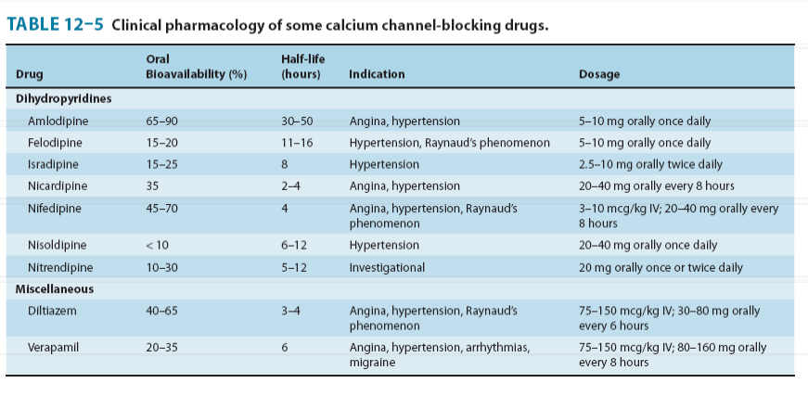
٩٧

Slide 98
Calcium Channel Blockers
They are exclusively L-type CCBs.
These drugs are orally active (some can be injected), characterized by high first-pass effect and high plasma protein binding.
Their metabolism is inhibited by grapefruit juice.
٩٨

Slide 99
Calcium Channel Blockers
Mechanism of Action:
Block L-type Ca²⁺- channels in cardiac and smooth muscles (L = long, large high threshold Ca²⁺ current).
Dihydropyridines bind to one type of receptors.
Verapamil and diltiazem bind to related
but not identical receptors.
٩٩

Slide 100
Calcium Channel Blockers
The drugs act from the inner side of the membrane and bind more effectively to open channels and inactivated channels.
Binding of the drug reduces the frequency of opening in response to depolarization.
١٠٠

Slide 101
Calcium Channel Blockers
The result is a marked decrease in transmembrane calcium current, which in smooth muscle results in long- lasting relaxation.
In cardiac muscle results in reduction in contractility and decreases in sinus node pacemaker rate and atrio- ventricular node conduction velocity.
١٠١

Slide 102
Calcium Channel Blockers
Potassium channels in vascular smooth muscle are inhibited by verapamil, thus limiting the vasodilation produced by this drug.
١٠٢

Slide 103
Calcium Channel Blockers
Organ-system effects:
1. Smooth muscle relaxation:
Arterioles are more sensitive than veins → reduce systemic vascular resistance. Therefore, orthostatic hypotension is not a common adverse effect.
١٠٣

Slide 104
Calcium Channel Blockers
Women may be more sensitive than men to the hypotensive action of diltiazem.
Improve angina of effort by reduction of peripheral vascular resistance, and relieve of coronary artery improves variant angina.
١٠٤

Slide 105
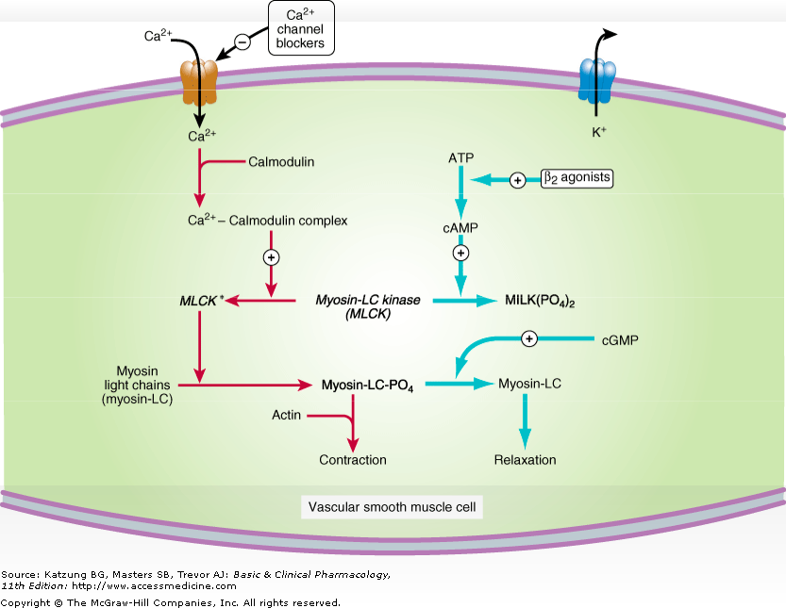
١٠٥

Slide 106
Calcium Channel Blockers
Dihydropyridines are more selective to vascular smooth muscle ↔ negligible effect on cardiac myocytes.
Blockade of vascular smooth muscle potassium channels reduce the effect of verapamil on vasodilation.
١٠٦

Slide 107
Calcium Channel Blockers
Dihydropyridines may differ in potency in different vascular beds. Nimodipine is more selective to cerebral blood vessels → relieves spasm following subarachnoid hemorrhage (withdrawn).
Nicardipine has similar effects.
١٠٧

Slide 108
Calcium Channel Blockers
2. Cardiac muscle:
Cardiac muscle is highly dependent on calcium influx during each action potential for normal function.
A. Reduction in cardiac contractility
reduces cardiac output and myocardial O₂ requirements in patients with angina.
١٠٨

Slide 109
Calcium Channel Blockers
Reduction of sinus rate.
Reduction of conduction through the AV-node. (slow-response, or calcium- dependent, action potentials)
Dihydropyridines are not effective on cardiac muscle.
١٠٩

Slide 110
Calcium Channel Blockers
Relaxation of bronchial, GI and uterine smooth muscle may also occur.
3. Skeletal muscles are not affected because they use intracellular Ca² pool and do not need much transmembrane Ca² influx.
١١٠

Slide 111
Calcium Channel Blockers
4. Others:
Verapamil blocks p-glycoproteins, efflux-transporter, and thus, may reduce resistance of cancer cell to chemotherapeutic agents.
١١١

Slide 112
Calcium Channel Blockers
Adverse Effects:
Cardiac depression: bradycardia, cardiac arrest, AV-block, and congestive heart failure (verapamil, diltiazem).
Flushing, dizziness, nausea, constipation and peripheral edema.
١١٢

Slide 113
Calcium Channel Blockers
Dihydropyridines:
Reflex sympathetic stimulation →
reflex tachycardia.
Renin secretion: retention of Na⁺ and water & vasoconstriction.
١١٣

Slide 114
Calcium Channel Blockers
Notes and precautions:
Verapamil and diltiazem should NOT be co- administered with β-blockers. Why? Dihydropyridines can! Why?
Dihydropyridines can be combined with verapamil and diltiazem.
Immediate release short-acting dihydropyridines can precipitate angina pectoris in patients with coronary artery disease – contraindicated. Why?
4. All can increase digoxin serum levels.
١١٤

Slide 115
Calcium Channel Blockers
Therapeutic Uses:
Hypertension
Angina pectoris and myocardial infarction
Supraventricular tachyarrhythmia's (Supraventricular tachycardia, atrial fibrillation and atrial flutter). NOT the dihydropyridines. Why?
١١٥

Slide 116
Inhibitors of the Renin- Angiotensin-Aldosterone System
Renin release from the renal cortex is stimulated by:
Reduced renal arterial pressure.
Sympathetic nerve stimulation (β₁).
3. Reduced sodium delivery to or increased sodium concentration at the distal renal tubule.
١١٦

Slide 117
Inhibitors of the Renin- Angiotensin-Aldosterone System
Angiotensin I is converted, primarily by endothelial ACE, to the arterial vasoconstrictor angiotensin II, which is in turn converted in the adrenal gland to angiotensin III.
١١٧

Slide 118
Inhibitors of the Renin- Angiotensin-Aldosterone System
Angiotensin II has vasoconstrictor and sodium-retaining activity.
Angiotensin II and III both stimulate aldosterone release.
Salt restriction, diuretics & vasodilators stimulate angiotensin production.
١١٨

Slide 119
Inhibitors of the Renin- Angiotensin-Aldosterone System
A system for angiotensin exists in several other tissues (heart), and may be responsible for trophic changes such as cardiac hypertrophy.
The ACE involved in tissue angiotensin II synthesis is also inhibited by ACE inhibitors.
١١٩

Slide 120
Angiotens inogen
Ka/Nk'e;n l
Kininogen
₁Renin
Increased
Angiotensin I
Bradyk.inin
prostaglandin synthesis
Angiotensin converting enzyrne (kininase II)
Angiotensin II
ACE
inhibitors
Inact ve metabolites
Vasoconst riction
Aldosterone secretion
Vasod ilation
1
Spirono,lactone, epler
l
enone
Increased peripheral vascular resistance
Increased sodium
Decreased peripheral vascular resistance
and water retention
/
l
Increased blood pressure
Decreased blood pressure
Source : Katzung BG.. Masters SB.. Tt'e...,o t' AJ : Basic & Clinical PharmacoJogy..
11h Edit:ion: http :// w w w . accessmedici n e. corn
Copyright © The McGraw - Hill Companie s ,. Inc. All rights reserved.

Slide 121
Inhibitors of the Renin- Angiotensin-Aldosterone System
Classification:
β-Adrenoceptor blockers.
Renin antagonist: aliskiren
Angiotensin converting enzyme inhibitors.
Angiotensin receptor blockers.
Aldosterone antagonists – spironolactone
١٢١

Slide 122
Angiotensin Converting Enzyme Inhibitors (ACEIs)
Captopril – short acting.
Enalapril – prodrug (enalaprilat, IV). Lisinopril – derivative of enalaprilat. Ramipril, benazepril, fosinopril,
moexipril, perindopril, quinapril, and trandolapril – prodrugs – long acting.
١٢٢

Slide 123
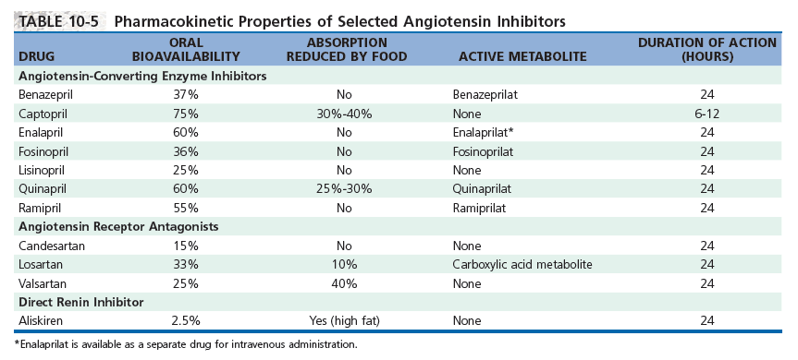
١٢٣

Slide 124
ACEIs
Mechanism of Action:
Inhibit peptidyl dipeptidase that hydrolyzes angiotensin I to angiotensin II, and inactivates bradykinin (plasma kininase), a potent vasodilator.
Bradykinin also stimulates release of nitric oxide and prostacyclin.
١٢٤

Slide 125
ACEIs
Angiotensin II is a vasoconstrictor. and bradykinin is a vasodilator.
ACEIs prevent formation of a vaso- constrictor and prevent degradation of a vasodilator.
They decrease peripheral vascular resistance without significantly changing cardiac out put and heart
rate.
١٢٥

Slide 126
ACEIs
They reduce sodium and water retention (due to reduced aldosterone).
They do NOT cause reflex sympathetic stimulation, may be because:
1. Of downward resetting of the baroreceptors.
١٢٦

Slide 127
ACEIs
Of enhanced parasympathetic activity.
They may block angiotensin presynaptic effects on catecholamine release
They are effective in hypertensive patients irrespective of plasma renin activity.
١٢٧

Slide 128
ACEIs
Clinical Pharmacology:
Hypertension
Diabetic nephropathy (even without hypertension): They reduce proteinuria and stabilize renal function by reducing efferent
arteriolar resistance in glomeruli and decreasing intraglomerular capillary pressure.
١٢٨

Slide 129
ACEIs
Heart failure: They reduce both preload and afterload.
Myocardial infarction: They reduce cardiac remodeling.
Reduce the incidence of diabetes in patients with high cardiovascular risk.
١٢٩

Slide 130
ACEIs
Adverse Effects:
1. Severe hypotension after initial doses, especially in hypovolemia as a result of diuretics, salt restriction, or gastrointestinal fluid loss.
١٣٠

Slide 131
ACEIs
2. Acute renal failure, particularly in patients with bilateral renal artery stenosis or renal artery stenosis of a solitary kidney.
In renal artery stenosis, renal perfusion is maintained by vasoconstriction of the efferent arteriole.
١٣١

Slide 132
ACEIs
Hyperkalemia (Why?)
Dry cough, wheezing, angioedema (due to bradykinin or substance P).
Captopril may cause proteinuria and neutropenia at high doses, especially in patients with renal insufficiency.
١٣٢

Slide 133
ACEIs
6. Others: Altered sense of taste, allergic skin rash, drug fever (10% of patients).
Contraindicated during pregnancy: Fetal hypotension, anuria, renal failure, malformations and death.
١٣٣

Slide 134
ACEIs
Drug Interactions:
K⁺ supplements and K⁺-sparing diuretics → Hyperkalemia.
Nonsteroidal antiinflammatory drugs may impair the antihypertensive
effect of ACEIs by blocking bradykinin-mediated vasodilation (PG portion).
١٣٤

Slide 135
Angiotensin-Receptor Blockers (ARBs)
Losartan, Valsartan, Candesartan, eprosartan, irbesartan, telmisartan, and olmesartan.
Block angiotensin II type 1 receptors (AT₁-R).
No effect on bradykinin.
١٣٥

Slide 136
ARBs
More complete inhibition of angiotensin II actions (Why?). Other enzymes generate angiotensin II.
Uses similar to ACEIs.
Adverse effects are similar to ACEIs except, wheezing, angioedema and cough which may occur much less
commonly.
١٣٦

